Slide 1
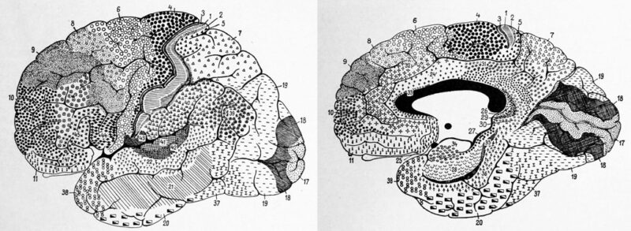

Introduction to Neuroscience Futures

Slide 2
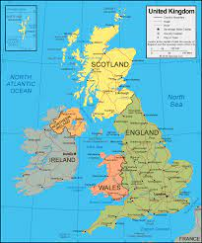
Dr Will Norton
Associate Professor of Animal Biology at the University of Leicester; Honorary Professor at ELTE
BSc (Neuroscience) at University of Sheffield
PhD (Developmental Neuroscience) at University
College London
Postdoctoral Research EMBL Heidelberg, Helmholtz
Centre Munich, CNRS, Gif/Yvette
Worked in Leicester since 2012

Slide 3
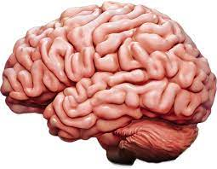
Neuroscience futures…
Why study the brain?
How does the brain process stimuli to tailor behavioural responses?
What happens when brain function is altered?
How can we study such complex processes in the lab?

Slide 4

Four topics:
Hacking the brain
> Techniques to manipulate brain function and measure the consequences
Neuroscience of social behaviour
> Types of social behaviour; the social brain; effect of isolation on behaviour
From neural circuits to behaviour
> How to identify and manipulate neural circuits; hunting as an example
Animal models of complex diseases
> How can we model complex diseases such as psychiatric disorders in fish?

Slide 5
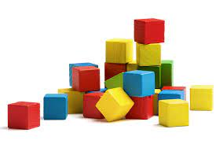
Structure of each topic
Each topic is split over two weeks, ~2h per week
Week 1: Self-guided study in own time
Listen to two short pre-recorded lectures, ~ 20 min each
Working in groups, prepare a short presentation of a pre-selected paper
Week 2: Two hour live sessions, 14:30 – 16:30
First hour – live lecture (break)
Second hour – presentations in groups
Material will be presented via Teams

Slide 6

Material will all be presented using Teams
Select “Files” from the top of the Teams page
Click on Files

Slide 7
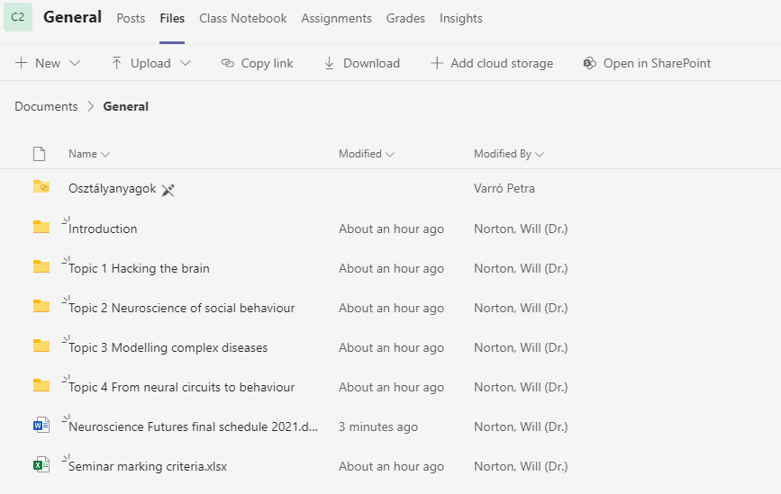
Each topic is contained in its own folder
Topic folders

Slide 8
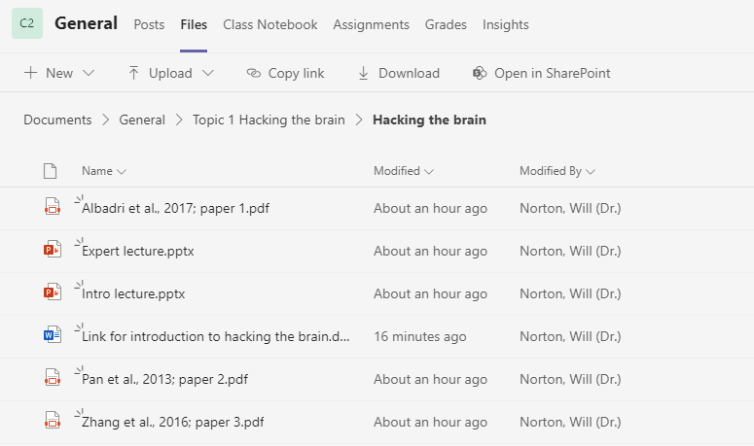
Each topic is contained in its own folder
The Teams site contains a folder with a copy of my slides, recorded lectures, background
reading etc
Each folder is used for the two weeks covered by a topic…

Slide 9
Each topic is contained in its own folder
My slides for you
to download
Link to watch
pre-recorded
lectures here
Papers for
group presentations
Group 1 = paper 1 etc

Slide 10

Topic folder also contain suggested reading
Some papers will be used for group presentations (more about this later!)
Others provide (optional) background reading for general interest and talk preparation
Other sources of information: PubMed, Web of Science, Google Scholar, Wikipedia (?)
Podcasts, Youtube videos, TED talks….

Slide 11
Module assessment
Each topic will end with group presentations of a paper (you choose which paper
out of a choice of three)
Each group presentation will be awarded a grade: 1st presentation is formative
(you can practise!). The next three presentations each make 33% of final mark
Presentations will be marked based upon information content, clarity of slides
Individual mark for presentation style
Each talk should be max. 10 min with 5 min for questions
Please email slides to me (whjn1@le.ac.uk ) before the presentation day
A marking scheme is available on Teams site

Slide 12
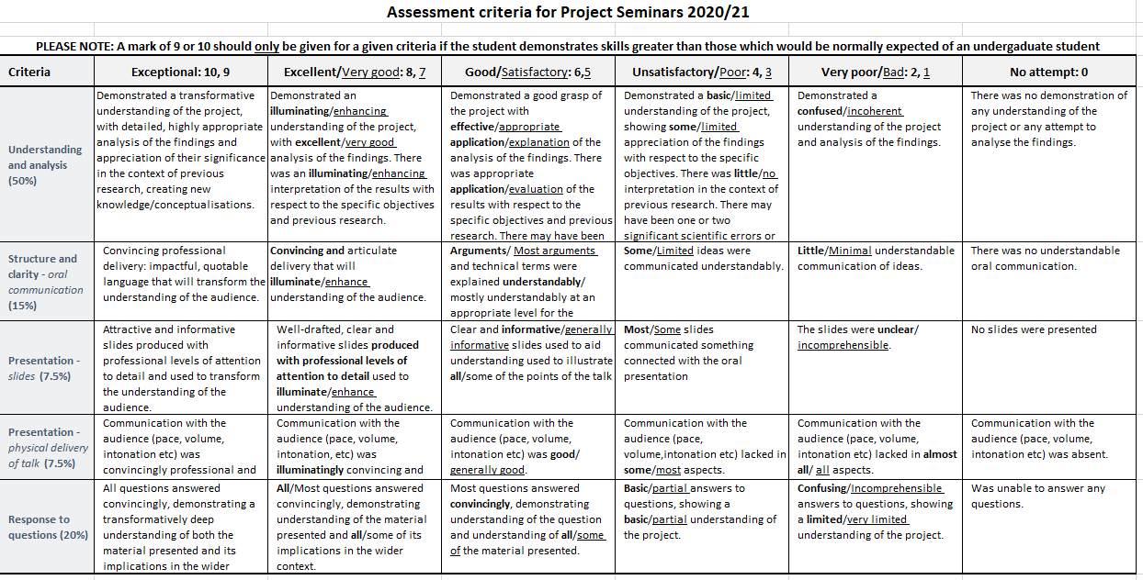
Marking scheme for presentations

Slide 13
Presentation groups
Group 1:
Group 2:
Group 3:

Slide 14
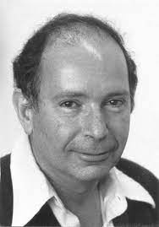
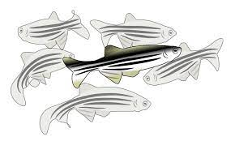
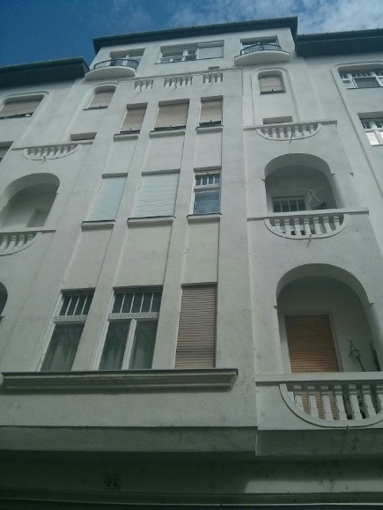
Zebrafish – a Hungarian model organism!
George Streisinger – Budapest and Oregon!
First to establish zebrafish as a model organism
ZF are easy to keep in the lab
Small, develop quickly, transparent at larval stages
Genetically manipulatable

Slide 15
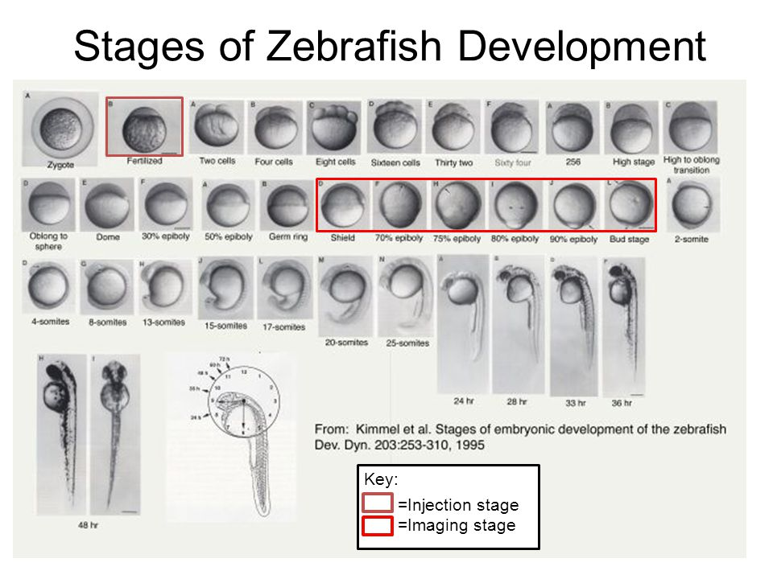

Zebrafish (Danio rerio)

Slide 16
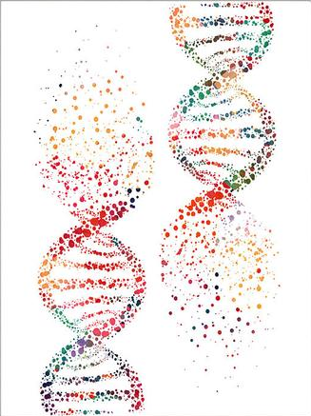
Zebrafish as a model organism
Zebrafish are small, easy to breed and can be manipulated genetically
Standard behaviour tests have been established
Gene expression can be measured by RNAseq, in situ hybridisation
Immunohistochemistry can be used to localise proteins
Transgenesis can locate proteins or manipulate their function
Genes can be over-expressed or knocked out
Optogenetics to investigate the function of neural circuits
Screens for drugs to alter behaviour

Slide 17
Zebrafish as a model organism
Zebrafish are small, easy to breed and can be manipulated genetically
Standard behaviour tests have been established
Gene expression can be measured by RNAseq, in situ hybridisation
Immunohistochemistry can be used to localise proteins
Transgenesis can locate proteins or manipulate their function
Genes can be over-expressed or knocked out
Optogenetics to investigate the function of neural circuits
Screens for drugs to alter behaviour

Slide 18
Questions about the module?

Slide 19
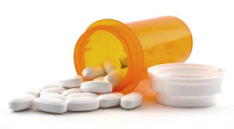

Screening for novel aggression therapeutics
Aggression is an adaptive behaviour used to gain territory, protect offspring and fight for resources
Maladaptive aggression can lead to injury or death
In humans, aggression is a symptom of psychiatric disorders including
attention-deficit/hyperactivity disorder and conduct disorder
Current drug treatments are poor and may have unwanted side-effects

Slide 20
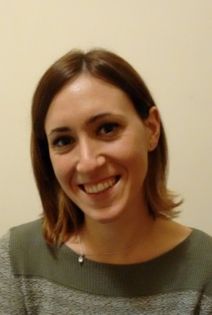
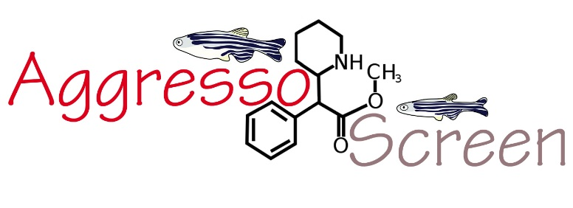
Screening for novel aggression therapeutics
Designed a phenotype-based screen to examine 110 novel drugs that reduce mirror aggression but not other behaviours
Biased screen based upon drugs identified by literature search
Screen each drug at 3 different concentrations (low, medium, high) on same day using acute (30 minute) treatment
Screen using 1 month old juvenile fish instead of adult
Use sedation/lack of swimming as read-out of general
drug effect
Irene Vacca

Slide 21
“Arnie” the aggressionator: juvenile aggression
Behaviour of 12 animals in parallel
Automatic quantification of aggression
Viewpoint Lifesciences

Slide 22
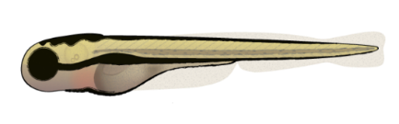
Screen design
Juvenile zebrafish

Slide 23
Automatic quantification correlates with manual analysis
Validation of automatic
quantification
Development of aggression
over time

Slide 24
Aggression is stable over time
Aggression is a visually-based behaviour
Aggression is stable throughout the day
Aggression is stable throughout the year

Slide 25
Changes to aggression following drug application

Slide 26
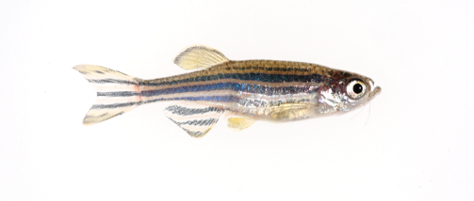

Changes to aggression in fgfr1a mutant line
Norton et al., 2011

Slide 27
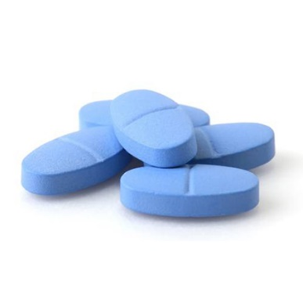
Screened 110 drugs for ability to alter aggression / locomotion

Slide 28
Results of first round of screen (example)
only 12.
Notes:
Hierarchical clustering based upon Tanimoto coefficient

Slide 29
Tested positive hits a second time using a larger number of fish
Selected drugs to study in more depth
Notes:
Note: reduction will be biased here, because we purposely selected for drugs that reduce aggression

Slide 30
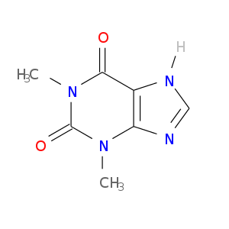
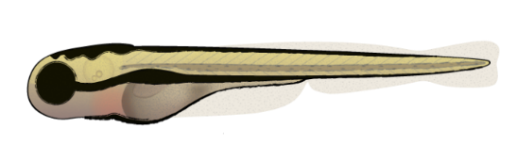
Example of positive hit: caffeine
n = 50

Slide 31
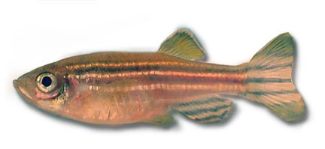
Caffeine also reduces adult aggression
Aggression
Locomotion
Aggression
Locomotion
Freezing
Erratic movements out of the mirror zone
Freezing
Time in mirror zone
Erratic movements
Time in mirror zone
n = 9 or 10 fish per group, 30 minutes treatment
Héctor Carreño

Slide 32
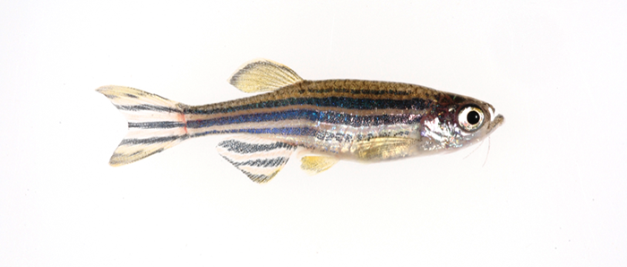
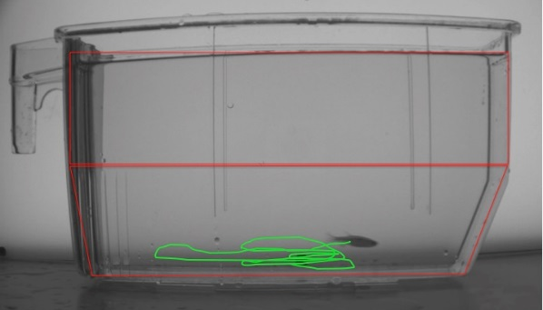
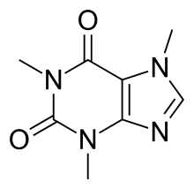
Caffeine does not alter adult anxiety-like behaviour
Time at bottom
Time at top
Distance swum
Notes:
At concentration used – much less than in other published studies (compare 100 uM to 520 uM).

Slide 33
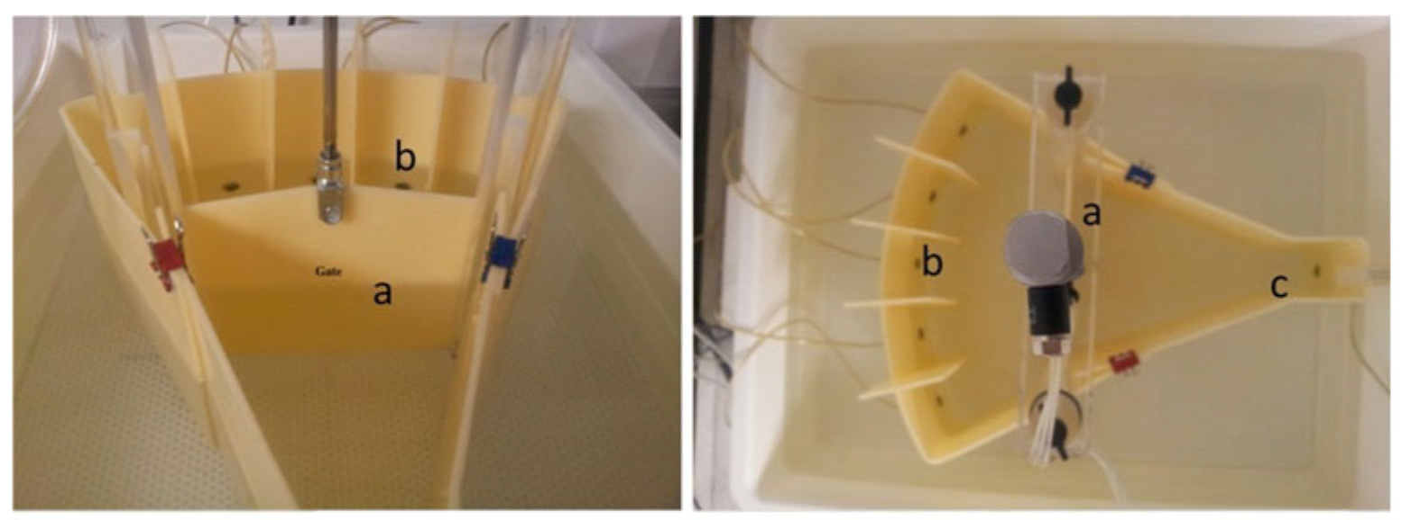
Caffeine alters impulsivity in the 5 choice serial reaction time task
Correct responses
Premature (impulsive) responses
Matt Parker
Portsmouth

Slide 34
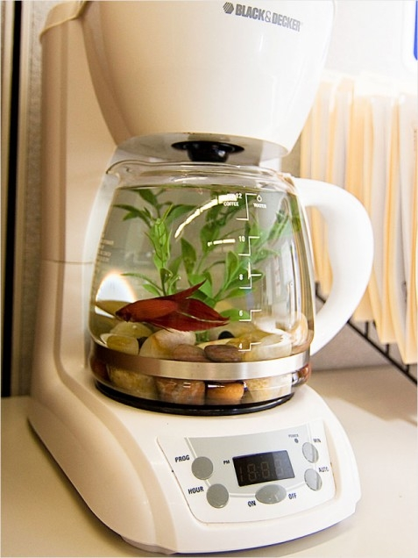
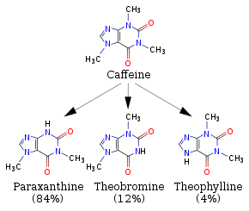
Neurobiology of caffeine
Adenosine A1 and A2A antagonist. Binds to phosphodiesterases and monoamine oxidase at higher concentrations
Metabolised in the liver to aminophylline,
paraxanthine, theobromine and theophylline
Pohanka, 2015
Notes:
Paraxanthine is major metabolite; theobromine and theophylline is also produced

Slide 35
Identified drugs structurally related to caffeine
Search for 10 most similar compounds in Pubchem (based upon Tanimoto coefficient)
Ranked by Pubchem ID, not similarity

Slide 36
Multidimensional scaling: similarity of caffeine-group drugs

Slide 37
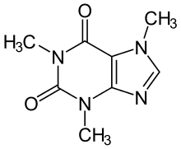
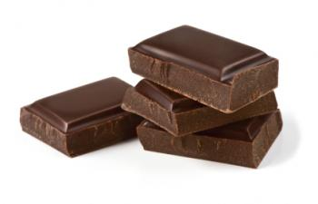
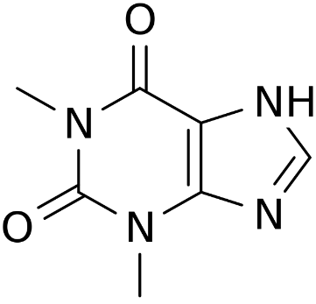
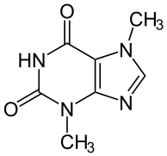
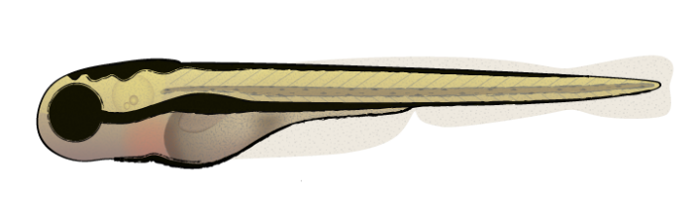
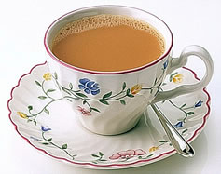
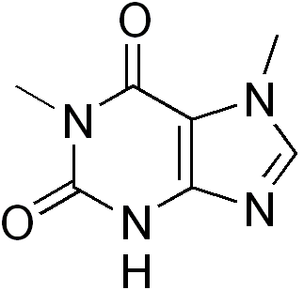
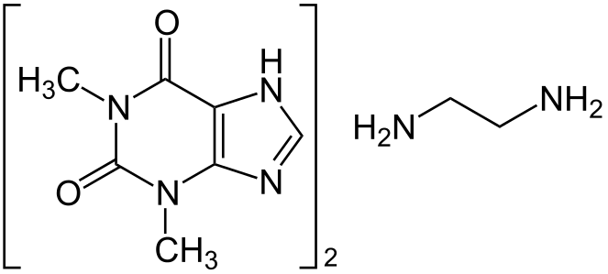
Local screen based upon caffeine derivatives
Caffeine
Theophylline
Theobromine
Paraxanthine
Aminophylline

Slide 38

Caffeine derivatives
Notes:
So caffeine could only function through being metabolised to paraxanthine…? Interesting possibility

Slide 39
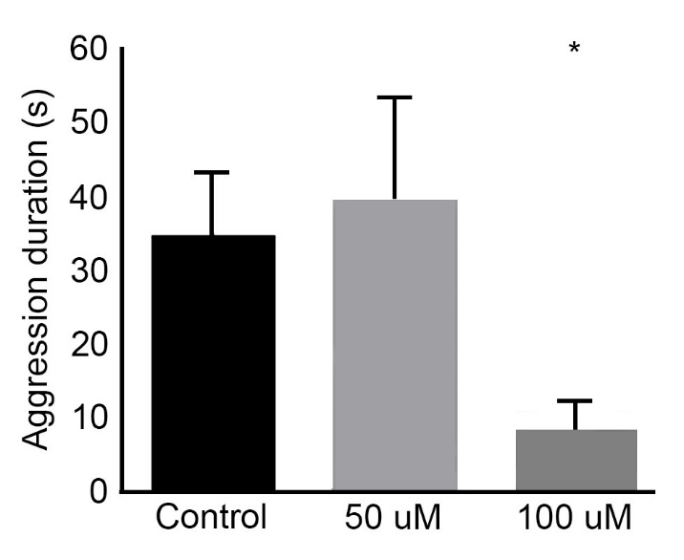
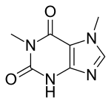
Paraxanthine also decreases adult aggression
Aggression
Locomotion

Slide 40

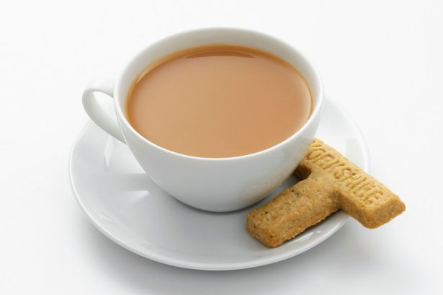

Caffeinated drinks
Coffee 267.5 mg/l
Tea 149.5 mg/l
Effective dose in adult fish:
200 µM (= 38.8 mg/l)
Coca Cola 55.5 mg/l
Pohanka, 2015

Slide 41
Anti-aggression effects in other species
Cherek et al., 1983: coffee decreases
punishment in an electric shock task
Wilson et al., 2000: caffeine reduces rat aggression

Slide 42
Summary of module: four topics
Hacking the brain
Self-guided study 23.09.22
Live session 30.09.22 14:30 - 16:30
Animal models of complex diseases
Self-guided study 07.10.22
Live session 14.10.22 14:30 - 16:30
Neuroscience of social behaviour
Self-guided study 21.10.22
Live session 28.10.22 14:30 - 16:30
From neural circuits to behaviour
Self-guided study 04.11.22
Live session 11.11.22 14:30 - 16:30

Slide 43

Questions?

